Slide 1
Unit 2
Introduction to Cells
** MAIN IDEA**
Cells are the basic unit of structure and function in all living things.

Slide 2
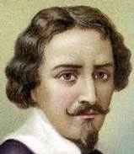
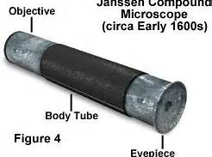
I. First to See Cells
A. About 1590, two Dutch eye glass makers, Zacharias Janssen and his son Hans, while experimenting with several lenses in a tube, discovered that nearby objects appeared greatly enlarged.

Slide 3
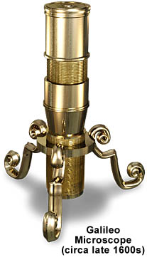
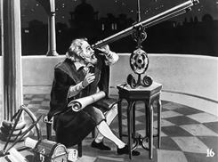
I. First to See Cells
B. In 1609, Galileo, father of modern physics and astronomy, worked out the principles of lenses, and added a focusing device to his microscope. Later, he went on to explore the heavens with his telescopes.

Slide 4
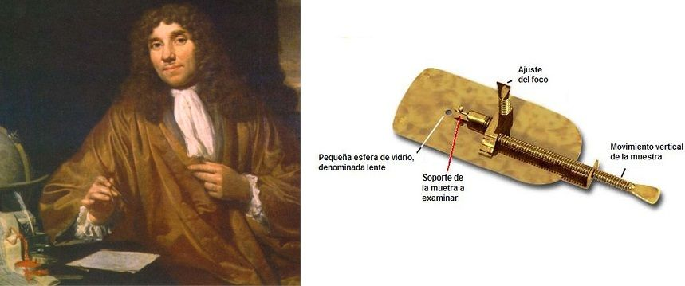
I. First to See Cells
C. Anton van Leeuwenhoek, in the mid 1600’s taught himself new methods which gave magnifications up to 270 times. This led to the building of his microscopes and the biological discoveries for which he is famous.

Slide 5
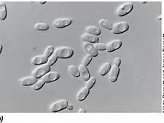
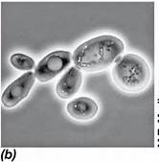
C. Anton van Leeuwenhoek
1. He was the first to see and describe bacteria, yeast plants, the life in a drop of water. He called them “wee beasties” and “animalcules”!

Slide 6
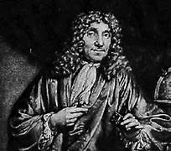
C. Anton van Leeuwenhoek
2. Because of his many contributions and discoveries, he has been called the "Father of Microscopy".

Slide 7
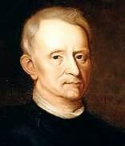
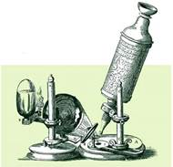
I. First to See Cells
D. Robert Hooke made a copy of Leeuwenhoek's light microscope and then improved upon his design.

Slide 8
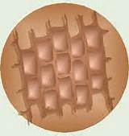
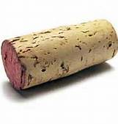
D. Robert Hooke
1. He looked at a piece of cork through a microscope lens and noticed some "pores" or "cells" in it.

Slide 9
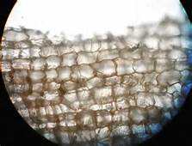
I. Robert Hooke
2. Hooke gained credit for discovering the building blocks of all life - the first to identify cells

Slide 10
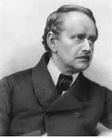
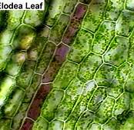
II. Cell Theory
A. History
1. In 1838 Matthais Schleiden proposed that every structural element of plants is composed of cells or the products of cells.

Slide 11
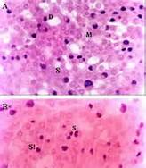
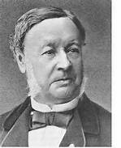
A. History
2. In 1839 a fellow German, Theodor Schwann, proposed that in animals too every structural element is composed of cells or cell products.

Slide 12
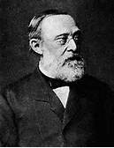
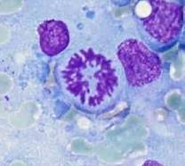
A. History
3. In 1855 Rudolf Virchow writes and publishes that every cell is produced from another cell.

Slide 13
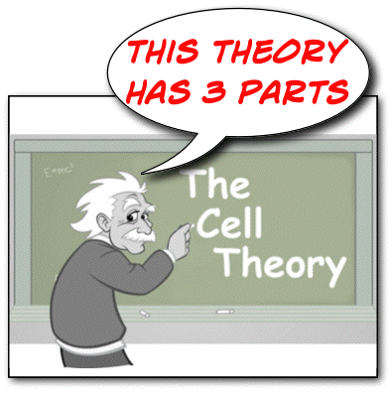
B. Cell Theory
1. All living things are made of cells.

Slide 14
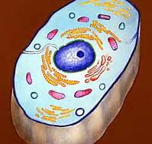
B. Cell Theory
2. Cells are the basic units of structure and function of life.

Slide 15
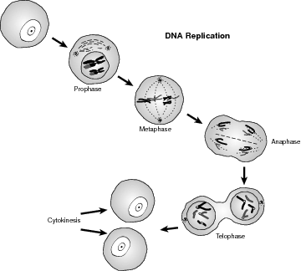
B. Cell Theory
3. Cells come only from other pre-existing cells.

Slide 16
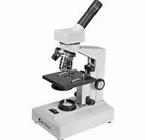
III. Microscopes
A. Compound Light Microscope
1. It works by light passing through an object and then combining the two sets of lenses it has to magnify and focus an image.

Slide 17
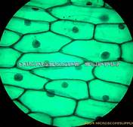
A. Compound Light Microscope
2. The magnification typically ranges from approximately 40 X to 1,000 X

Slide 18
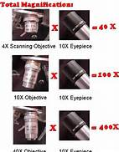
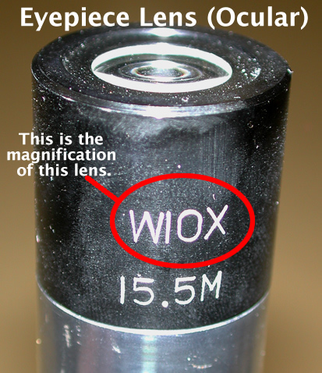
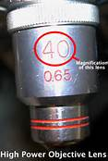
A. Compound Light Microscope
3. The total magnification of an image is calculated by multiplying the magnification of the ocular by the magnification of the objective

Slide 19
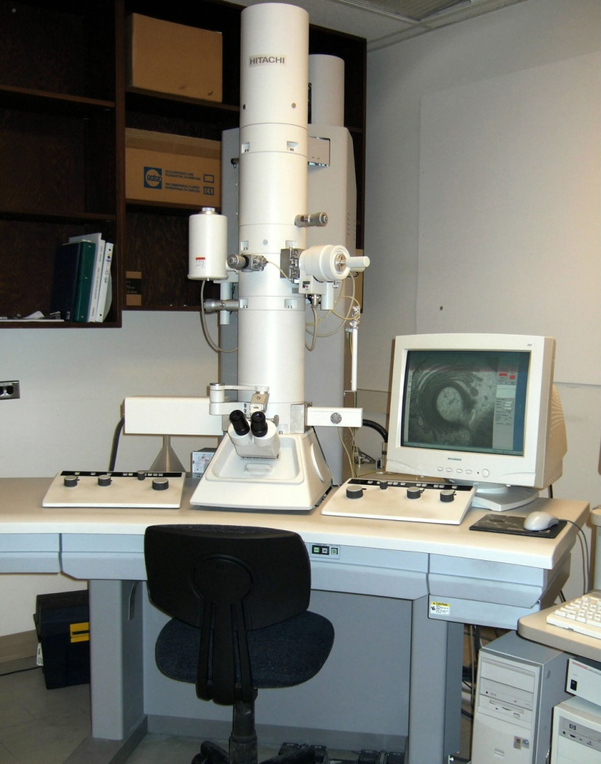
B. Electron Microscope
1. It transmits electrons through a small piece of a specimen.

Slide 20
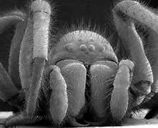
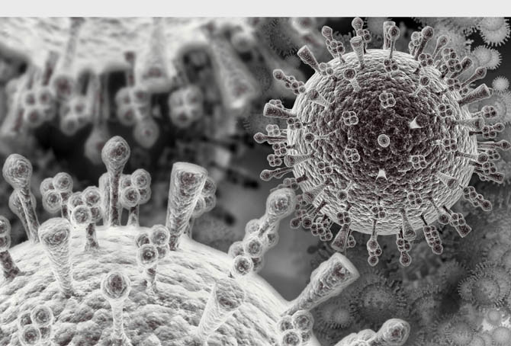
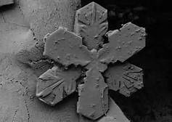
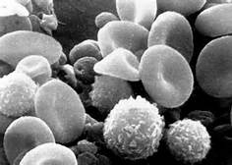
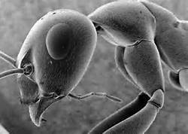
B. Electron Microscope
2. It allows a person to see microscope images magnified up to two million times

Slide 21
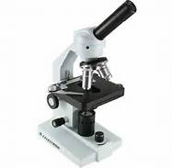
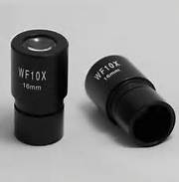
C. Parts of a Compound Light Microscope
1. Eyepiece: this is used for viewing and it contains a lens that magnifies.

Slide 22
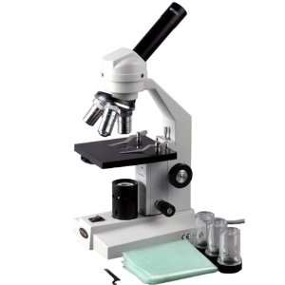
C. Parts of a Compound Light Microscope
2. Arm: supports the eyepiece.

Slide 23
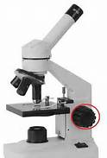
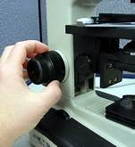
C. Parts of a Compound Light Microscope
3. Coarse focus knob: brings an object into focus at low or medium power.

Slide 24
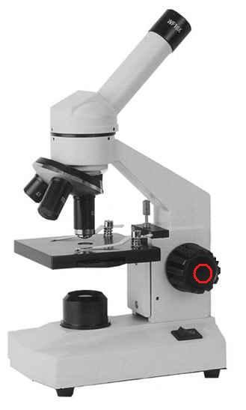
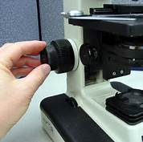
C. Parts of a Compound Light Microscope
4. Fine focus knob: brings an object into focus at high power.

Slide 25
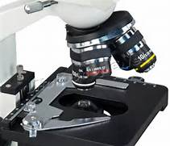
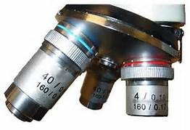
C. Parts of a Compound Light Microscope
5. Objective lenses: magnifies the image.

Slide 26
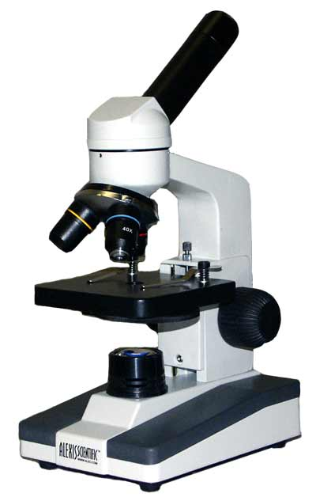
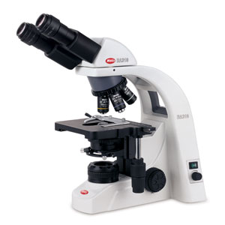
C. Parts of a Compound Light Microscope
6. Revolving nosepiece: Holds the three objective lenses.

Slide 27
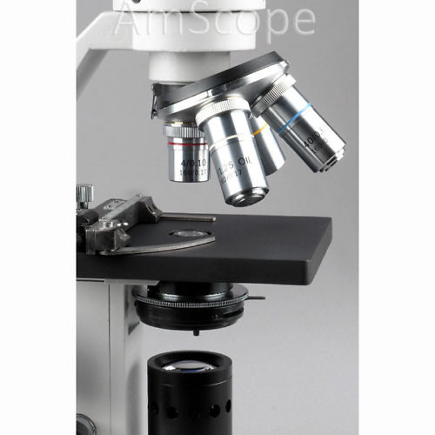
C. Parts of a Compound Light Microscope
7. Stage: supports the slide.

Slide 28
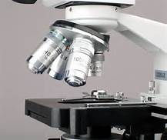
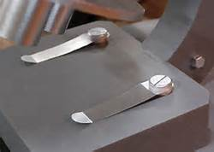
C. Parts of a Compound Light Microscope
8. Stage clips: holds the slide in place.

Slide 29
C. Parts of a Compound Light Microscope
9. Light source: supplies light to view the slide.

Slide 30
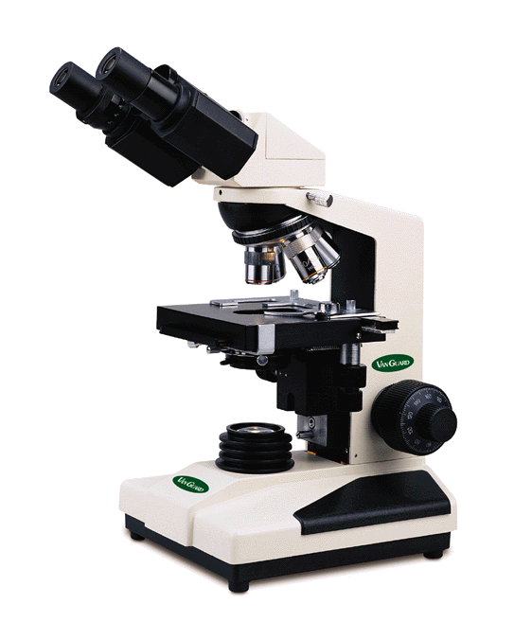
C. Parts of a Compound Light Microscope
10. Base: supports the entire microscope.

Slide 31
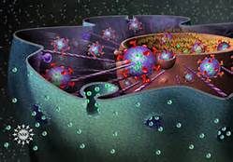
Cell Parts

Slide 32
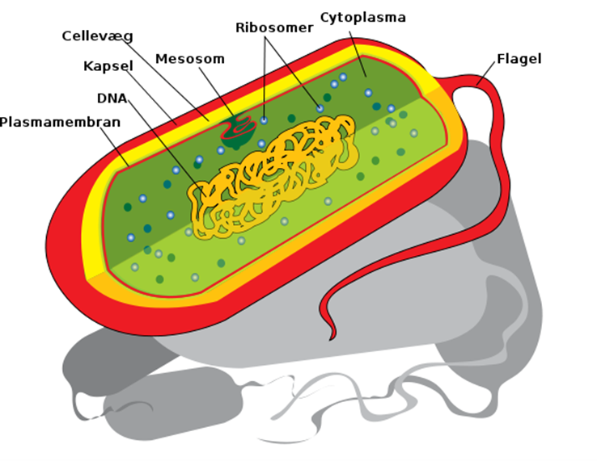
IV. Cell Type
A. Prokaryotes do not have a nucleus or any other membrane bound organelles.

Slide 33
IV. Cell Type
B. Eukaryote have a membrane bound nucleus and other organelles within each of their cells.

Slide 34
IV. Animal Cells
A. Cell Membrane
1. the outer boundary of the cell.

Slide 35
A. Cell Membrane
2. Double layer of phospholipids with proteins

Slide 36
A. Cell Membrane
3.it is selectively permeable - allows some molecules to pass through, while keeping others out.

Slide 37
A. Cell Membrane
4. Maintains homeostasis

Slide 38
B. Nucleus
1. Large oval body near the center of the cell.

Slide 39
B. Nucleus
2. The control center for all activity.

Slide 40
B. Nucleus
3. Contains the hereditary material of the cell - DNA.
a. at this stage they are called Chromatin
b. they will later become Chromosomes

Slide 41
B. Nucleus
4. Surrounded by a nuclear membrane.

Slide 42
B. Nucleus
5. Fluid in nucleus is called nucleoplasm

Slide 43
C. Nuclear Membrane (envelope)
1. Surrounds nucleus

Slide 44
C. Nuclear Membrane (envelope)
2. It is selectively permeable - allows some molecules to pass through, while keeping others out.

Slide 45
C. Nuclear Membrane (envelope)
3. Openings in the Nuclear envelope are referred to as nuclear pores.

Slide 46
C. Nuclear Membrane (envelope)
4. Controls movement of materials in/out of nucleus

Slide 47
D. Nucleolus
1. is found in the nucleus.

Slide 48
D. Nucleolus
2. Contains more genetic information (RNA)

Slide 49
D. Nucleolus
3. Make ribosomes

Slide 50
E. Cytoplasm
1. Cell material outside the nucleus but within the cell membrane.

Slide 51
E. Cytoplasm
2. Clear thick fluid.

Slide 52
E. Cytoplasm
3. Contains structures called organelles.

Slide 53
F. Vacuoles
1. clear fluid sacs that act as storage areas for food and waste.

Slide 54
F. Vacuoles
2. In animal cells the vacuoles are much smaller.

Slide 55
G. Mitochondria
1. Power house of the cell.

Slide 56
G. Mitochondria
2. They release energy for cell functions.

Slide 57
G. Mitochondria
3. Peanut shaped

Slide 58
H. Ribosomes
1. Tiny spherical bodies.

Slide 59
H. Ribosomes
2. Found in the cytoplasm or attached to the endoplasmic reticulum.

Slide 60
H. Ribosomes
3. Synthesizes proteins

Slide 61
I. Endoplasmic Reticulum ( ER )
1. A network or maze of passageways throughout the cytoplasm.

Slide 62
I. Endoplasmic Reticulum ( ER )
2. It connects the nuclear membrane to the cell membrane.

Slide 63
I. Endoplasmic Reticulum ( ER )
3. Passageway for material moving though the cell.

Slide 64
I. Endoplasmic Reticulum ( ER )
4. They also produce many substances

Slide 65
I. Endoplasmic Reticulum ( ER )
4. Rough ER have ribosomes attached. Smooth ER does not.

Slide 66
J. Golgi Apparatus (Sometimes they call them the golgi bodies)
1. Stacks of flattened sacs.

Slide 67
J. Golgi Apparatus (Sometimes they call them the golgi bodies)
2. They receive proteins from the ER, package them, and distribute them to other parts of the cell or outside of the cell.

Slide 68
K. Lysosomes
1. Digest old cell parts and then releases the substances so they can be used again. Like a recycling factory

Slide 69
K. Lysosomes
2. They also contain enzymes which are used in digestion, breaking down food particles into smaller ones

Slide 70
K. Lysosomes
3. If a lysosome were to burst it could destroy the cell.

Slide 71
L. Cytoskeleton
1. Made of various types of special proteins

Slide 72
L. Cytoskeleton
2. Strengthen cell and helps maintain the shape

Slide 73
M. Centrioles
1. Made of microtubules

Slide 74
M. Centrioles
2. Assist in cell division

Slide 75
II. Plant Cells
A. Cell Wall
1. Rigid layer that protects and supports the cells of plants and some other organisms.

Slide 76
A. Cell Wall
2. Made up of a tough fiber called cellulose.

Slide 77
B. Chloroplasts
1. Contain a green pigment known as chlorophyll which is important for photosynthesis.

Slide 78
B. Chloroplasts
2. The chlorophyll in the chloroplast gives plants their green color

Slide 79
B. Chloroplasts
3. capture energy from the sun and changes it into a form of energy that can be used in making food.

Slide 80
C. Vacuoles
1. In plant cells the vacuoles are large and mostly filled with water.

Slide 81
C. Vacuoles
2. This gives the plant support.

