Slide 1
Unit 4
Cell Division / Reproduction / DNA

Slide 2
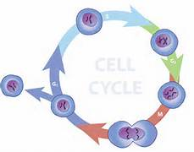
I. Mitosis
A. Cells go through a repeating series of events called the cell cycle.

Slide 3
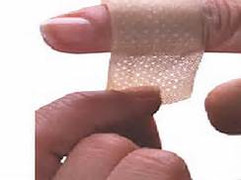
I. Mitosis
B. The purpose of cell division
1. Growth. 1 cell becomes 2. 2 becomes 4 and so on.
2. Repair. Replace aging or damaged cells.
3. Reproduction. Some organisms reproduce through cell division.

Slide 4
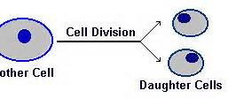
I. Mitosis. Also known as the Cell Cycle
C. The process of eukaryotic cells to produce daughter cells that are genetically identical to the parent.

Slide 5
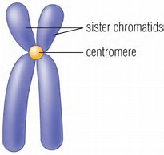
D. Interphase – the phase before cell division
1. Growth
2. Replication – the process when the makes an exact copy of its DNA
a. at the end of replication, cells contain two identical sets of chromatids.
b. Chromosomes consist of two chromatids joined by a centromere.

Slide 6
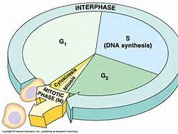
D. Interphase – the phase before cell division
3. Preparation for cell division.
4. 90% of a cells time is spent in interphase

Slide 7
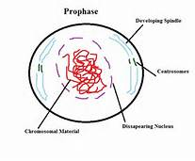
E. Prophase
1. Chromosomes condense and become more visible.

Slide 8
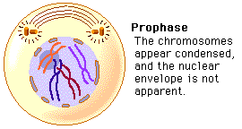
E. Prophase
2. The nuclear envelope breaks down.

Slide 9
E. Prophase
3. Pairs of centrioles begin to move to opposite ends of cell.

Slide 10
E. Prophase
4. Spindle fibers form between the centrioles

Slide 11
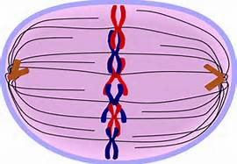
F. Metaphase
1. The centrioles are now at opposite poles of the cell.

Slide 12
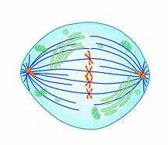
F. Metaphase
2. The chromosomes become arranged in the middle .

Slide 13
F. Metaphase
3. Spindle Fibers attach to the centromeres of the chromosomes.

Slide 14
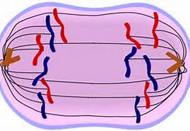
G. Anaphase
1. Sister chromatids separate, and the new chromosomes move to opposite poles of the cell.

Slide 15
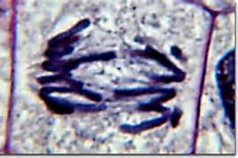
G. Anaphase
2. At the end of anaphase, a complete set of chromosomes has assembled at each pole of the cell.

Slide 16
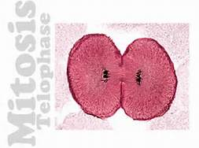
5. Telophase
a. The chromosomes assemble in sets at the two poles.

Slide 17
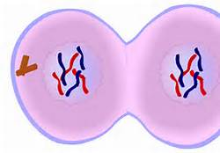
5. Telophase
b. A nuclear envelope reforms around each chromosome set.

Slide 18
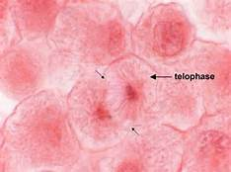
5. Telophase
c. The spindle fibers disappear

Slide 19
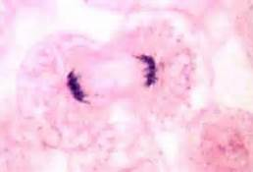
5. Telophase
d. Chromosomes return to chromatin

Slide 20
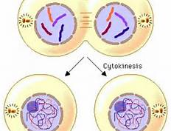
6. Cytokinesis
a. Cell membrane moves inward to create two daughter cells

Slide 21
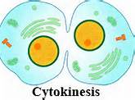
6. Cytokinesis
b. each with its own nucleus and the same number and type of chromosomes as the parent

Slide 22
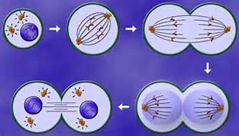
D. Mitosis is a form of asexual reproduction - reproduction that requires only one parent and produces offspring genetically identical to itself.

Slide 23
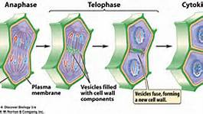
E. Differences in mitosis in plant cells
1. Plants have no Centrioles
2. Plant cells grow a cell plate between the 2 cells.

Slide 24
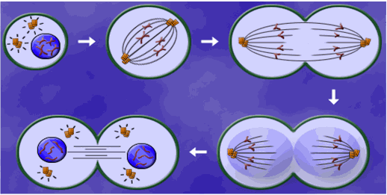
II. Asexual Reproduction
A. Involves only one parent. Offspring are identical to the parent. All forms of asexual reproduction are variations of the cell division process of mitosis.

Slide 25
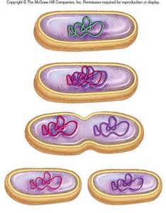
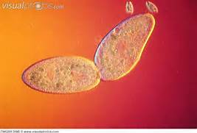
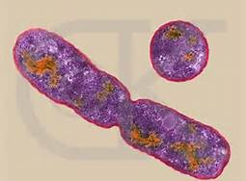
II. Asexual Reproduction
B. Binary Fission involves an equal division of both the organism’s cytoplasm and nucleus to form two identical organisms. Only single celled organisms reproduce this way – Bacteria, Protists

Slide 26
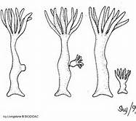
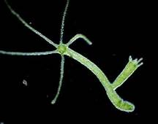
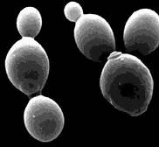
II. Asexual Reproduction
C. Budding is when a parent develops a smaller version of itself that eventually detaches and becomes its own independent organism. Examples are Coral, Hydra, and Yeast

Slide 27
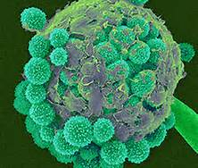
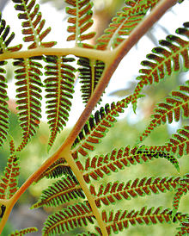
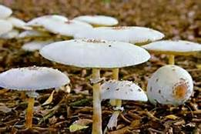
II. Asexual Reproduction
D. Spore Formation is reproduction involving specialized single cells coming from one parent. Examples are Fungus, Molds. It is similar to seeds but are usually smaller and in much greater numbers

Slide 28
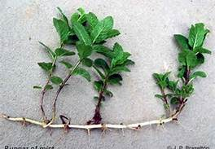
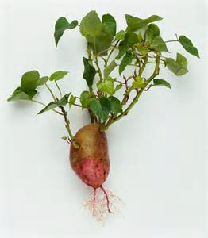
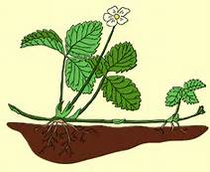
II. Asexual Reproduction
E. Vegetative Reproduction – reproduction of a plant that does not involve a seed. Runners, cuttings, tubers – strawberries, potatoes

Slide 29
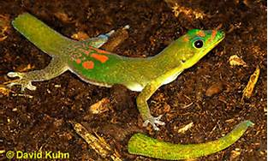
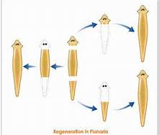
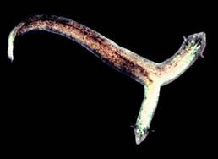
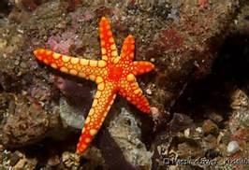
II. Asexual Reproduction
F. Regeneration is the ability to replace lost or damaged body parts. This ability varies greatly among living things.

Slide 30
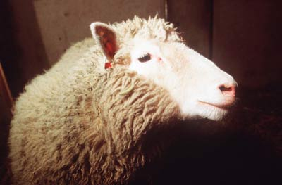
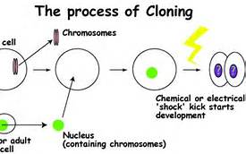
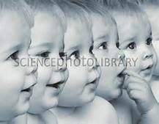
II. Asexual Reproduction
G. Asexual reproduction is sometimes called cloning. Cloning is the production of identical genetic copies.

Slide 31
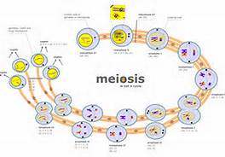
III. Meiosis
A. A special type of cell division that produces cells with half the number of chromosomes.

Slide 32
III. Meiosis
B. The purpose of meiosis is to have a cell containing the diploid number of chromosomes converted into four cells, each having the haploid number of chromosomes. In human cells, for instance, a reproductive cell containing 46 chromosomes yields four cells, each with 23 chromosomes.

Slide 33
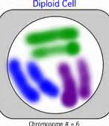
III. Meiosis
1. Any cell with two sets of chromosomes is called a diploid cell.

Slide 34
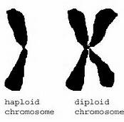
III. Meiosis
2. A cell with a single set of chromosomes is called a haploid cell.

Slide 35
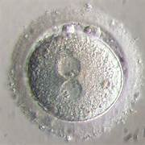
C. Process of Meiosis
1. Meiosis is similar to mitosis, except there are two consecutive cell divisions, Meiosis I and Meiosis II, resulting in 4 daughter cells instead of 2.

Slide 36
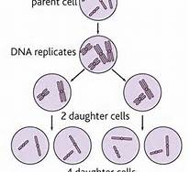
C. Process of Meiosis
2. Meiosis I is almost identical to Mitosis.

Slide 37
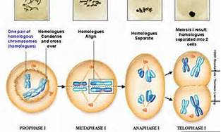
C. Process of Meiosis
3. In Meiosis II, the chomosomes do NOT undergo replication.

Slide 38
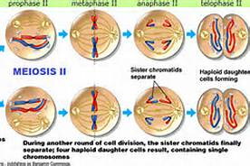
C. Process of Meiosis
4. Therefore, Meiosis II separates the chromatids in each of the two cells. This creates four daughter cells each with 23 chromosomes (haploid)

Slide 39
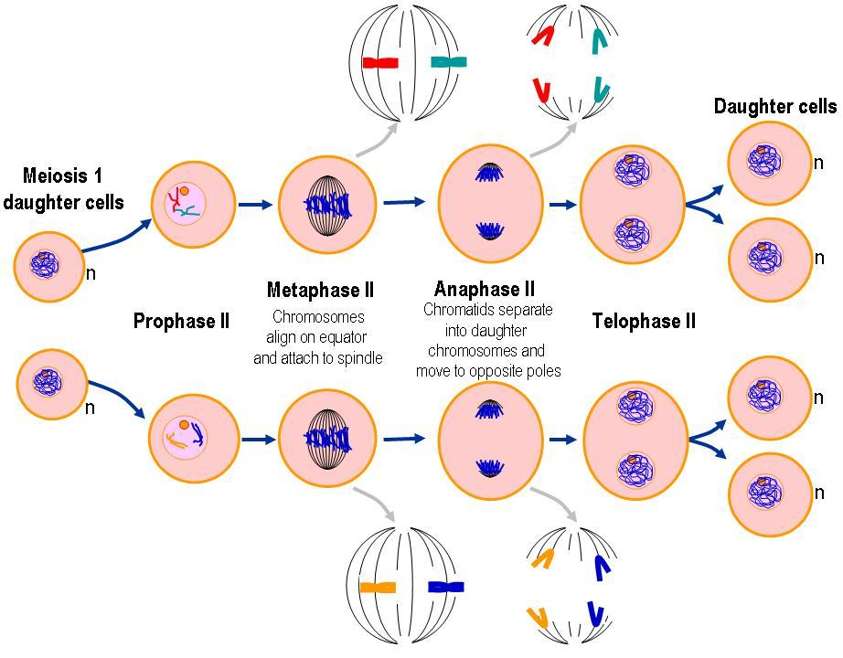
C. Process of Meiosis
5. So, meiosis involves two divisions producing a total of four daughter cells; with all four of them being genetically different.

Slide 40
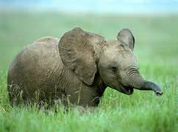
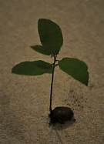
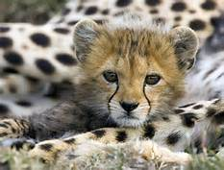
IV Sexual Reproduction
A. Involves two parents. The resulting offspring receives one copy of each gene from the male and one from the female. In other words, each person receives half of their genes from their mother and half from their father.

Slide 41
IV Sexual Reproduction
B. Gametes (reproductive cells) come from different parents. These cells are produced as a result of Meiosis.

Slide 42
IV Sexual Reproduction
1. Sperm comes from the male
2. Egg comes from the female

Slide 43
IV Sexual Reproduction
3. Fertilization is when egg and sperm are joined.
4. Fertilized egg is called a zygote.

Slide 44
IV Sexual Reproduction
5. Zygote goes through mitosis becoming an embryo.
6. Embryo develops into a multicellular organism.

Slide 46
DNA

Slide 47
I. History
A. Rosalind Franklin first to take an X-ray photo of DNA in 1951

Slide 48
I. History
B. James Watson and Francis Crick interpreted the photo and discovered the double helix structure in 1953. (They won the Nobel Prize in 1962)

Slide 49
II. What is DEOXYRIBONUCLEIC ACID?
A. DNA is sometimes called "the blueprint of life" because it contains the code, or instructions. Just like a builder uses a blueprint to build a house, DNA is used as the blueprint, or plans, for the entire organism.

Slide 50
II. What is DEOXYRIBONUCLEIC ACID?
B. DNA is the chemical component of chromosomes, which are located in the nucleus of every cell.

Slide 51
II. What is DEOXYRIBONUCLEIC ACID?
C. Each cell has 2 meters of DNA. Each person has approximately 75 billion cells. That is enough DNA to go from the earth to the sun 400 x’s.

Slide 52
II. What is DEOXYRIBONUCLEIC ACID?
D. A Gene is a segment of DNA that codes for a protein, which in turn codes for a trait (skin tone, eye color, etc),

Slide 53
III. Structure
A. The shape of the DNA molecule is a double-helix (like a twisted ladder).

Slide 54
III. Structure
B. The sides of the ladder are composed of alternating sugars (deoxyribose) and phosphates.

Slide 55
III. Structure
C. The rungs of the ladder are composed of nucleotides (also called Bases)
1. Adenine, Thymine, Guanine, Cytosine or A, T, G, C

Slide 56
III. Structure
C. The rungs of the ladder are composed of nucleotides (also called Bases)
2. Nucleotides pair in a specific way - called the Base-Pair Rule
a. Adenine pairs to Thymine
b. Guanine pairs to Cytosine

Slide 57
III. Structure
C. The rungs of the ladder are composed of nucleotides (also called Bases)
3. The rungs of the ladder can occur in any order (as long as the base-pair rule is followed)

Slide 58
III. Structure
4. For instance, a stretch of DNA could be AATGACCAT - which would code for a different gene than a stretch that read: GGGCCATAG.
All in all, there are billions of bases (nucleotides) in cells, which code for all the things an organism needs to function.

Slide 59
III. Structure
D. DNA is complementary
1. Complementary: bases on one strand match up with the bases on the other strand (A-T and G-C)
2. Example: Strand 1- ATG GGC CTA
Strand 2- TAC CCG GAT

Slide 60
IV. Replication
A. Replication is the process where DNA makes a copy of itself. Cells divide in order for an organism to grow or reproduce. DNA replicates right before a cell divides. During interphase of Mitosis!

Slide 61
IV. Replication
B. DNA replication is semi-conservative. That means that when it makes a copy, each new piece of DNA is made up of 1 old strand and 1 new strand . This helps reduce the number of copy errors.

Slide 62
C. The Process
1. Replication starts at a specific sequence on the DNA molecule.

Slide 63
C. The Process
2. An enzyme unwinds and unzips DNA, breaking the hydrogen bonds that join the base pairs, and forming two separate strands.

Slide 64
C. The Process
3. The new DNA is built up from the four nucleotides (A, C, G and T) that are abundant in the nucleoplasm.

Slide 65
C. The Process
4. These nucleotides attach themselves to the bases on the old strands by complementary base pairing. Where there is a T base, only an A nucleotide will bind, and so on.

Slide 66
C. The Process
5. The sides will reform the sugar-phosphate backbone.

Slide 67
C. The Process
6. A winding enzyme winds the new strands up to form a double helix.

Slide 68
C. The Process
7. The two new molecules are identical to the old molecule

Slide 69
V. RNA
A. RNA = ribonucleic acid.

Slide 70
V. RNA
B. RNA is similar to DNA except:
1. has one strand instead of two strands. 2. has the nitrogen base uracil instead of thymine 3. has the sugar ribose instead of deoxyribose

Slide 71
V. RNA
C. DNA remains in the nucleus, but in order for it to get its instructions translated into proteins, it must send its message to the ribosomes, where proteins are made.

Slide 72
V. RNA
D. The chemical used to carry this message is Messenger RNA
1. mRNA has the job of taking the message from the DNA in the nucleus to the ribosomes in the cytoplasm.
2. Transcription - RNA is made from DNA

Slide 73
V. RNA
E. tRNA matches amino acids in the cytoplasm to their place on the mRNA in the ribosome
1. Translation (protein synthesis): Process of making a protein
2. Proteins are made up of amino acids (small building blocks)
3. There are 20 different types of amino acids

Slide 75
VI. Mutations are a change in the DNA sequence.
A. DNA is a very stable molecule, and it doesn't suddenly change without reason, but bases can change when DNA is being replicated. Normally replication is extremely accurate but once in a while mistakes do occur (such as a T-C base pair).

Slide 77
VI. Mutations are a change in the DNA sequence.
B. Changes in DNA can lead to changes in cell function

Slide 78
VI. Mutations are a change in the DNA sequence.
C. Mutations can be
1. harmful – diseases or deformities
2. helpful – make it better able to survive
3. neutral – organism is unaffected

